Slide 1

Factors Contributing to Graduation Rates in New Jersey Schools
By a Sampling of Select Cities
Rutgers Data Science Boot Camp
January 12, 2019

Slide 2
Our Team
Our Questions
What Contributes to Graduation Rates in New Jersey?
The Fab Five
Kimberly Andersen
Deepali Khaparde
Adriana Kopf
Richa Prakash
Raghi Ramachandran
Contributing Factors in the Cities
Population
Demographics
Income and Poverty Rates
Contributing Factors in the Schools
Teachers’ Salaries
Administrators’ Salaries
Superintendents’ Salaries
Teacher Effectiveness
Dropout Rates

Slide 3
Our Data
Our Methodology
Determine Cities to Use
To represent varying geographic location, population, demographics, and affluence level, we chose:
Summit
Hoboken
Princeton
Clifton
Bridgeton
Main Data Sources:
https://www.census.gov
https://www.nj.gov/education
https://www.kaggle.com
https://www.njspotlight.com
Initial Data Analysis
Choose Most Reliable Data
Cleaned Data
Got to Work!

Slide 4
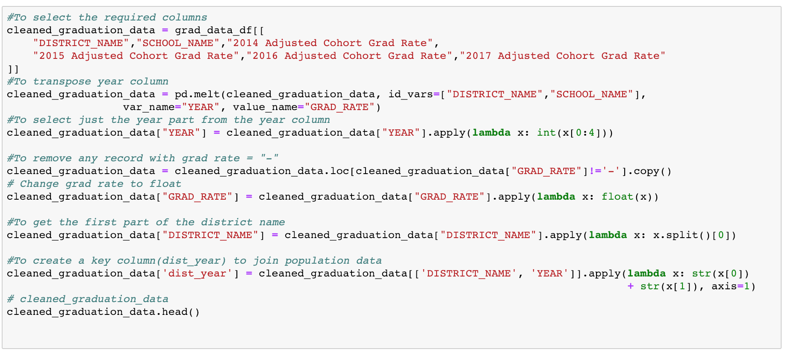
Cleaning the Data

Slide 5
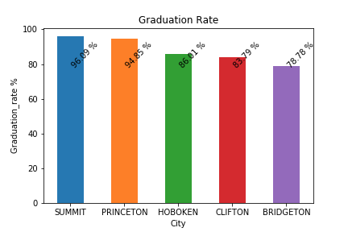
Our First Chart
Graduation Rate

Slide 6
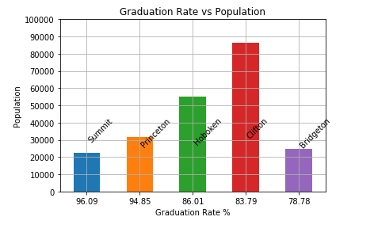
Our First Comparison
Graduation Rate and Population

Slide 7
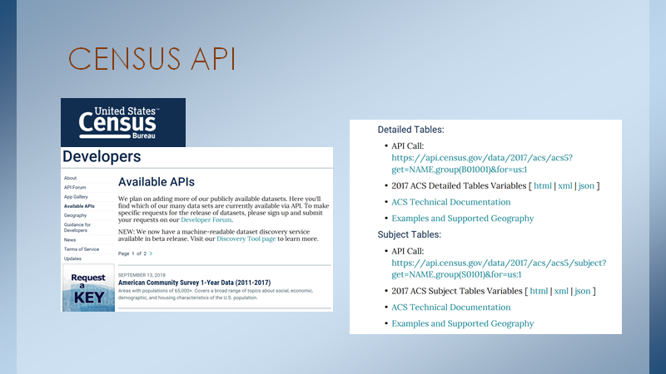

Slide 8
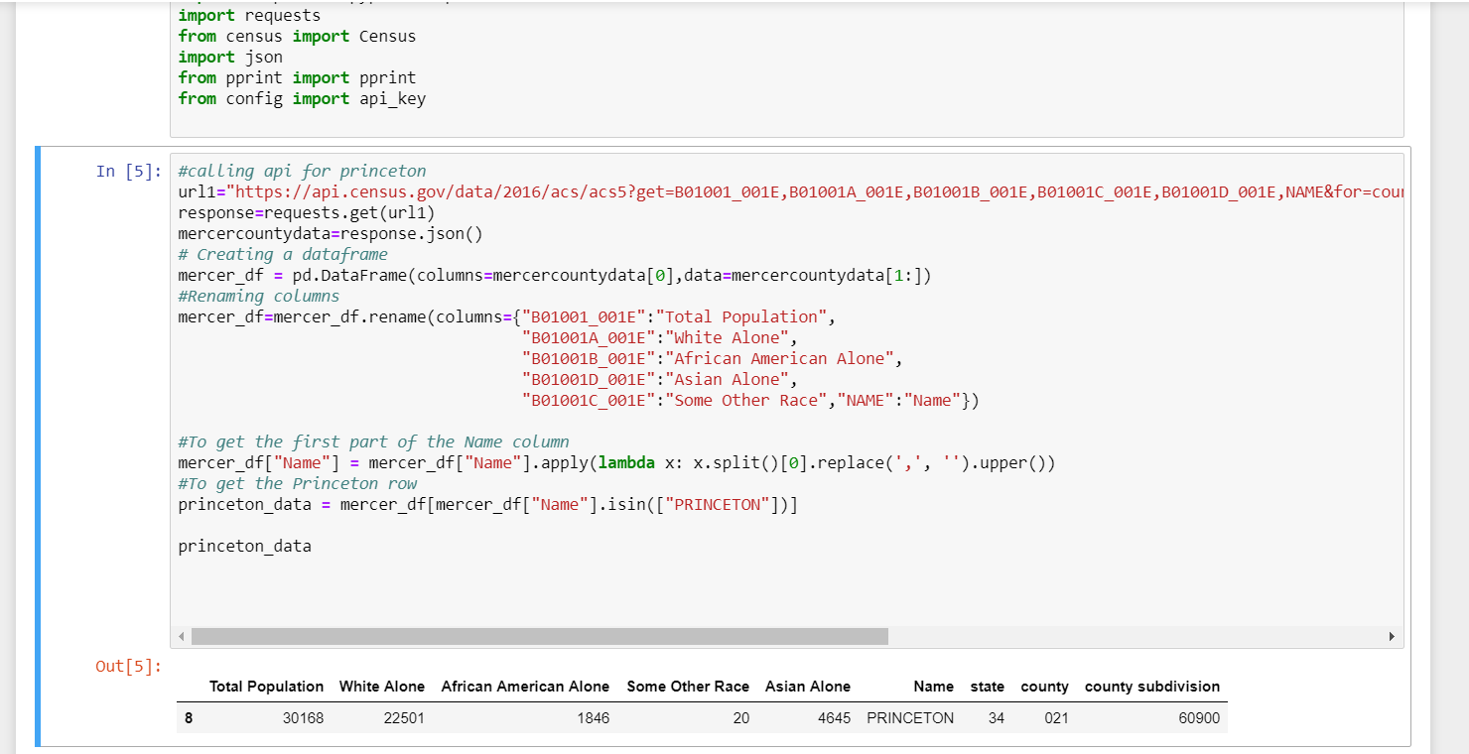
API Code

Slide 9
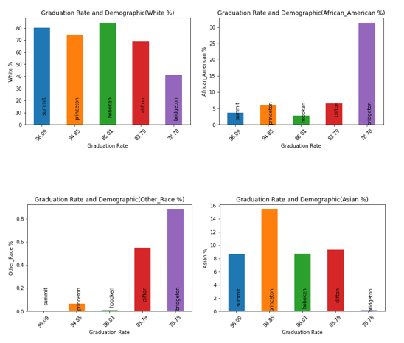
Individual Demographics vs Graduation Rate

Slide 10
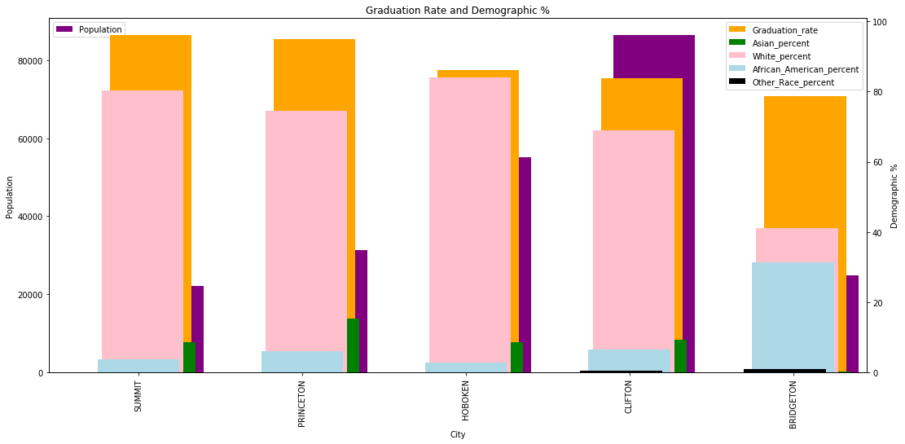
Combined Demographics with Population

Slide 11
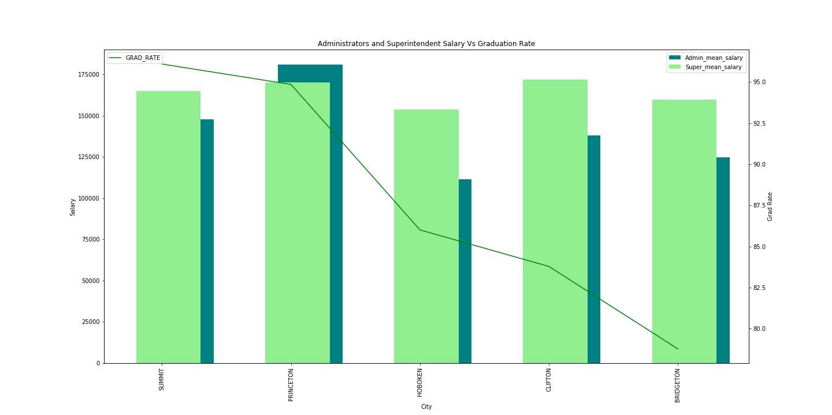
Administrator and Superintendent Salary vs Graduation Rate

Slide 12
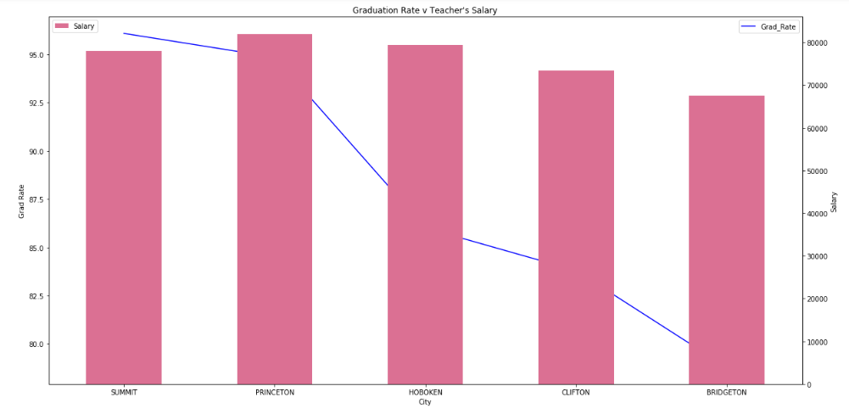
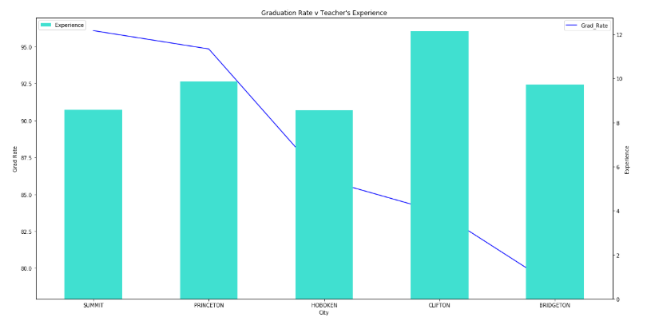
Teachers’ Salary vs Graduation Rate
Teachers’ Experience vs Graduation Rate

Slide 13
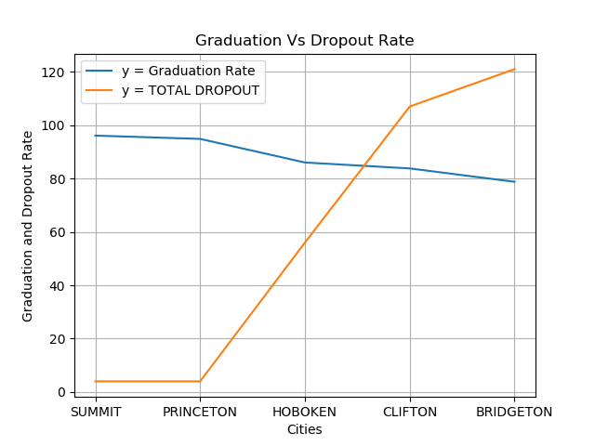
Dropout Rate vs Graduation Rate

Slide 14
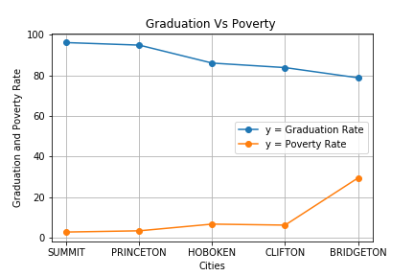
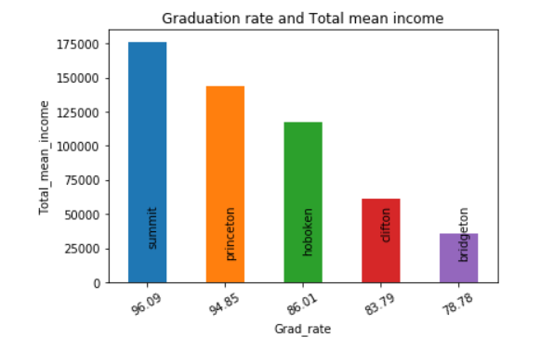
Poverty Rate vs Graduation Rate
Mean Income vs Graduation Rate

Slide 15
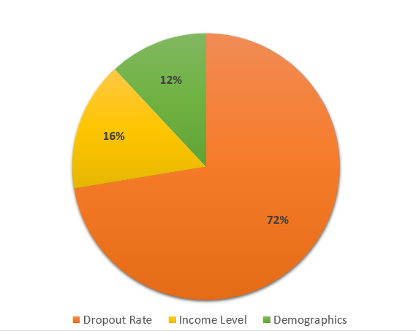
Conclusion
Percentage of Contributing Factors to Schools with the Lowest Graduation Rates in New Jersey

